Slide 1
TUGB Revolution
Concept for a revolutionary TUGB test line for tires
Cycle time savings of 4 -> 8 seconds compared to a conventional TU machine
fully automatic rim change integrated in full mixed operation
fully automatic rim width adjustment without affecting throughput
one-time filling of the tire for all measurements and markings
No adjustment of the belt conveyor - width required, no stripper
two or more spindles for uniformity / geometry / balancing / marking
comparatively simple balancing concept without adjustment of the mouth width
extremely large range of tire dimensions possible
Marking on the inflated tire is possible
Concept can also be extended to high-speed machines
Use of robots is recommended
Hanover, March 2025, Siegmar Ahlvers

Slide 2
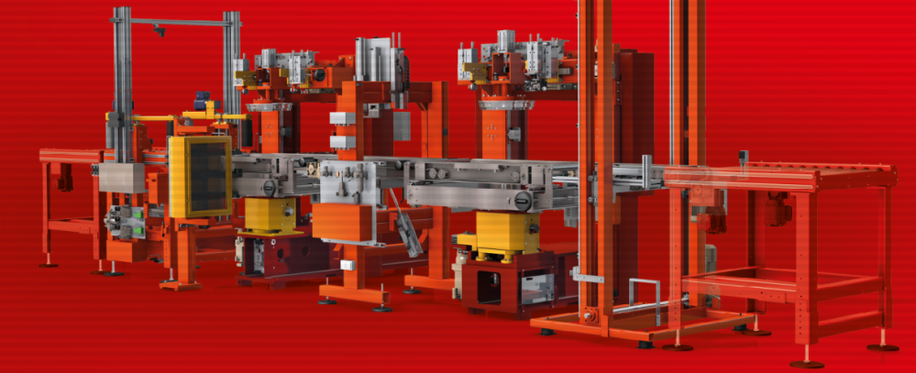
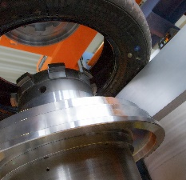
TUGB Revolution
Conventional UGB test line for tires
Bead lube station
Measuring station TU / (TG)
Rim change assistent 01
Marking station 01
Measuring station TB / (TG)
Rim change assistent 02
Marking station 02
Sorting lift

Slide 3
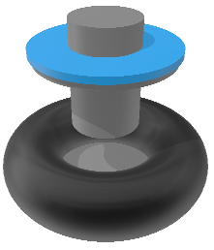
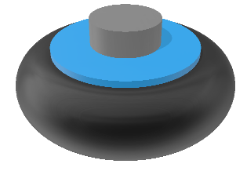
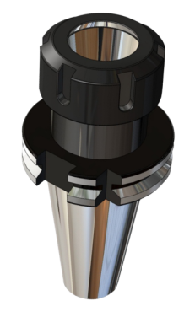
TUGB Revolution
Revolutionary UGB test : Test wheel instead of tire
Core component
Tire Collet Chuck
Upper single step rim (2 steps optionally), valve for inspection pressure
jacket with rim interlock and rim width adjustment
Lower single step rim, central hole for collet chuck
RFID chip for tooling compensation
together with the tire it forms the tire test wheel or measurement wheel
Rim width adjustment, chuck
Central Valve
tire test wheel
collet chuck to spindle

Slide 4
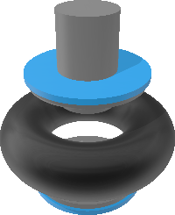
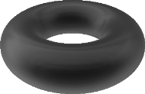
TUGB Revolution
Revolutionary UGB inspection line: linear structure
rim set / clamping collet storage
optionally: cleaning station
Lube
Assembly
Inspection Pressure (filling bell)
TU
TB/TG
Marking
Disassembly
Sorting
<<<Return of tire test wheel set

Slide 5
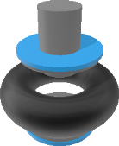
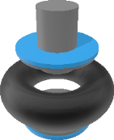
TUGB Revolution
Revolutionary UGB inspection line: optimized circular layout
Lube
Assembly
Filling bell
TU
TB/TG
Marking
Disassembly
Sorting
Feed in
Return of test wheel set to storage
Feed out

Slide 6
TUGB Revolution
Typical market leader machine
Conventional UGB test line for tires: process steps measuring station
TU@2Bar cw/ccw 18s +TG@4Bar 4s: 22s cycle time
Measuring station TU / TG
Set the rim width when changing the article
Center the tires in the conveying direction
Place the tire on the lower rim
Feed in the upper rim
Lock the rims
Tighten tires with setting pressure
If necessary, adjust the rim width for soft tires
Apply test pressure TU
Bring tires up to speed
TU measurement including change of direction of rotation with 2 directions
Test pressure TG
TG measurement
Optionally: rotate tire to marking angle
Deflate tire
Unlock the rims
Strip off tire
Move the lifting table to the transport level
Feed out tire
Optionally: TB measurement in the next station, repeat steps 1 to 7 etc.

Slide 7
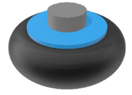
TUGB Revolution
<= 14s expected!
Revolutionary UGB test line for tires: process steps in 2 measuring stations
TU
Measuring station (1) TU cycle time max 14s
Center the tire test wheel in the conveying direction
Clamp the tire test wheel on the TU spindle
Bring tire test wheel up to speed
TU measurement including change of direction of rotation (2 directions)
Release the tire test wheel and move it to the next measuring station (2)
Measuring station (2) TB / TG cycle time less 14s
Clamp the tire test wheel on the TB spindle
Bring tire test wheel up to speed
TB measurement
Test pressure TG
TG measurement
rotate tire test wheel to marking angle and apply marks
alternatively mark tire in a seperate marking station
Release tire test wheel to disassembling unit
Deflate tire test wheel and release the tire
Feed out empty tire test wheel tools back to tooling unit
Feed out tire to sorting station
TB/TG
TU@2Bar cw/ccw: 14s
TB @2Bar TG@4Bar: less 14s incl. marking
2 tires measured on 2 spindles simultaneously, therfore max .14s cycle time per tire

Slide 8
TUGB Revolution
Revolutionary UGB inspection line: Part machines, structure
Lube station
Tire / test wheel assembly station, Inflation bell / Inspection pressure, Test wheel storage
Measurement station TU
Drop Conveyor optional for intermediate storage of tire test wheel
Measurement station TB / TG
Marking station
Tire / test wheel disassembly station / test wheel return station
Sorting lift / Robot

Slide 9
TUGB Revolution
Revolutionary UGB inspection line: Lube station functions
Lube station functions
receive the tire
center the tire
lube the bead
read barcode
detect position of barcode
turn tire with respect to the barcode to conveying direction
conveying the tire to assembly station
Lube

Slide 10
TUGB Revolution
Revolutionary UGB inspection line: Assembly station functions
Assembly station functions
conveying well centered lower part of test wheel from test wheel storage
Receive tire and position it on the lower part of test wheel
Adjust rim width to required bead width of the tire
Assembly of upper part of the test wheel
Feed complete assembly to inflation bell
Assembly

Slide 11
TUGB Revolution
Revolutionary UGB inspection line: Inflation bell functions
Inflation bell functions
Receive test wheel
To lower the inflation bell and press to the tire sidewall
Inflation to test pressure
Release inflation bell
Conveying the test wheel to the TU station
Alternative to the inflation bell method: inflation via valve, use of gravity for tires with soft sidewalls. The upper rim is guided "loosely" and rises when the test pressure is applied
Inflation bell

Slide 12
TUGB Revolution
Revolutionary UGB inspection line: TU function
TU functions
Receive test wheel with tire
Clamp test wheel
Execute TU measurement
Conveying test wheel to TB / TG station
TU

Slide 13
TUGB Revolution
Revolutionary UGB inspection line: TB/TG functions
TB/TG functions
Receive measurement wheel with tire
clamping of measurement wheel
Excecute TB measurement
Tooling compensation via RFID chip
Inflate to TG pressure 4 Bar
Excecute TG measurement
Conveying test wheel to marking station
TB/TG

Slide 14
TUGB Revolution
Revolutionary UGB inspection line: Marking functions
Marking functions
Receive test wheel with tire
Clamping of test wheel
Apply markings
Conveying of test wheel to disassembly station
Marking

Slide 15
TUGB Revolution
Revolutionary UGB inspection line: Disassembly functions
Disassembly functions
Receive test wheel with tire
Disassembly of tire
Return test wheel set back to storage
Conveying tire to sorting lift
Disassembly

Slide 16
TUGB Revolution
Revolutionary UGB inspection line: Sorting lift functions
Sorting lift functions
Receive tire
Adjust lift to outfeed level
Conveying of tire to conveying system
Sorting

Slide 17
TUGB Revolution
Summary
This TUGB final finishing concept would be quite demanding to realize.
The machinery itself could be more or less standard as it is used in the tire wheel assembly industry.
However the tooling would require a lot of precision, specially if you consider tire balancing measurement. The „artificial wheel“ has to consist of top and bottom rims, a valve and the possibility to adjust to different rim width. A precision collet would be required too. All parts need to be balanced extremely well and sustainable. Here I see the main bottleneck. However it would be interesting to know if any tire producer had tested such a concept.
In case of interest for discussion you may contact me preferably by email to siegmar@ahlvers.de.
Hanover, March 2025

